Slide 1
Deriving and Managing Data Products in an Environmental Observation and Forecasting System
Laura Bright
David Maier
Portland State University

Slide 2
Introduction
Large-scale scientific workflows common in many domains
Data-intensive tasks generate large volume of data products
Datasets, images, animations
Data products may be inputs to subsequent tasks

Slide 3
Motivation: CORIE
Environmental Observation and Forecasting System for Columbia River Estuary
Single forecast run generates over 5GB of data
Existing workflow consists of Perl, C, and FORTRAN programs
Difficult to modify and track tasks and data products

Slide 4
Segment of CORIE Forecast Workflow
start.pl
ELCIRC
*_salt.63
*_temp.63
*_vert.63
…
master_process.pl
do_isolines.pl
do_transects.pl
compute_plumevol.c
plumevol*.dat
do_plumevol.pl
plot_plumevol.pl

Slide 5
Challenges
Creation of data products
  Tasks are time and data intensive
  Competition for limited resources
  Opportunities for concurrent execution
Management of data products
  Products are large (100s of MB)
  Tracking metadata and lineage (how data product was generated)

Slide 6
Contributions
Experiences implementing data product management system
Managing data products and tasks
  Lineage Tracking
  Versioning
Scheduling challenges and opportunities
Prototype implementation and evaluation

Slide 7
Outline
Introduction
CORIE Environmental Observation and Forecasting System
Implementation using Thetus
Scheduling
Related Work and Conclusions

Slide 8
CORIE Overview
Measure and simulate physical properties of Columbia River Estuary e.g., salinity, temperature
Forecast simulations (daily)
  Predict near-term conditions
  5GB, 30,000 files
Hindcasts (as needed)
  Extended simulations or calibration runs
  20GB, 10,000 files
Total of 8TB of online storage

Slide 9
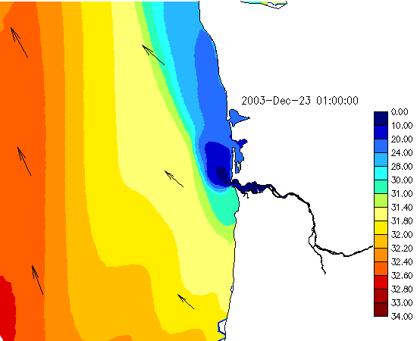
Example: Isolines

Slide 10
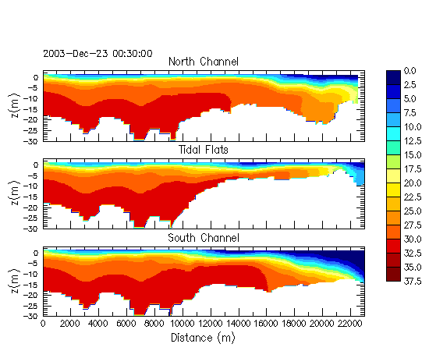
Example: Transects

Slide 11
Execution Environment
Dedicated storage and processors
Use all available capacity
Variety of runs, e.g.:
  Simulations
  Data product generation
  Calibration runs
Different runs may compete for resources
Existing implementation runs sequentially on single processor

Slide 12
Our Goals
Speed up workflows via concurrency
  Execute independent tasks on dedicated Grid (set of processing nodes)
Seamlessly adding processor nodes
Improve ease of adding and modifying data products and tasks
Lineage and metadata tracking

Slide 13
Outline
Introduction
CORIE Environmental Observation and Forecasting System
Implementation using Thetus
Scheduling
Related Work and Conclusions

Slide 14
Thetus Overview
Used Thetus™ commercial software
Non-text scientific data management
Storing and querying data files and metadata
Automatically launches tasks when conditions met
Using commercial software enabled rapid deployment of experimental system

Slide 15
Thetus Terminology
Data file
Property
  Metadata attributes associated with data files or descriptions
Description
  Set of property-value pairs
Profile
  Share properties between a set of files
  May launch one or more tasks on a file
Every entity has a unique ID

Slide 16
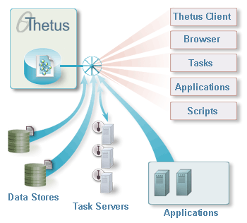
Thetus Architecture

Slide 17
Our Thetus Deployment
Modified existing CORIE tasks to execute as Thetus tasks
  Enable concurrent execution of independent tasks at separate nodes
Use Thetus storage facilities for executable programs as well as data products
Maintain default versions
Store data locally at nodes

Slide 18

Our Thetus Deployment
input files
Thetus Publisher
Data stores
data products
& executables
inputs & executables
data products
Task Server Nodes

Slide 19
Tasks in our Deployment
Generation tasks
  Generate derived data products
Management tasks
  Automatically maintain executables and metadata
  Updating versions
  Metadata extraction

Slide 20
Executing a Generation Task
Generation Task Plot_Plumevol:
File:
plumevol.dat
Profile:
plumevol_profile
Task:
plot_plumevol
File:
plumevol.gif
Input:
plumevol.dat
Output:
plumevol.gif
Task:
plot_plumevol

Slide 21
Storing Executables
Easily add and modify tasks
Old versions remain stored
  Regenerate older data products
Easily adding task server nodes
  Executables downloaded to nodes as needed
Associate data products with actual programs that generated them

Slide 22
Accessing Current Versions
We store all versions of executables for historical purposes
How to identify current version?
Management task tracks current version of file
No need to explicitly use ID

Slide 23
Accessing Current Versions
Management Task Set_Default:
File: prog.pl
ID: 123
Profile:
Set_Default_
Profile
Task:
Set_Default
Description:
prog.pl
Properties:
Default_ID:
123
Task:
Set_Default

Slide 24
Storing Data at Task Server Nodes
Many tasks share common inputs
Local data stores can reduce data transfer overhead
Need to ensure correct version
Solution: store file IDs locally
Check if local ID matches default, if yes, no need to download file

Slide 25
Outline
Introduction
CORIE Environmental Observation and Forecasting System
Implementation using Thetus
Scheduling
Related Work and Conclusions

Slide 26
Scheduling Issues
Task Splitting
Data aware scheduling
Workflow aware scheduling

Slide 27
Task Splitting
Modified tasks that iterate over multiple files to process single file
Enables concurrent execution of task on different files at separate nodes
Minimal changes to existing code

Slide 28
Data-Aware Scheduling
Many tasks process the same large files
Assign tasks based on location of input files
Reduce data transfer overhead

Slide 29
Workflow Aware Scheduling
Consider both currently ready and future workflow tasks
Example: four tasks and two nodes
Time
0
1
Task1
Task2
Task3
Task4
Tasks 1,2,3 ready at time 0, Task 4 at time 1

Slide 30
Workflow Aware Scheduling
Suboptimal: Assign tasks to nodes 1 and 2 as they become ready:
Node A
Node B
Improved: Assign tasks 1,2,3 to Node 1, Task 4 to Node 2
Node A
Node B

Slide 31
Results
Current Implementation: 3 nodes
Used do_transects and do_isolines
do_transects
  4 input files – 3 334MB, 1 655MB
do_isolines
  11 input files – 3 334MB, 1 655MB, 7 23MB
Many tasks have shared inputs
Takes 19-20 min on single node

Slide 32
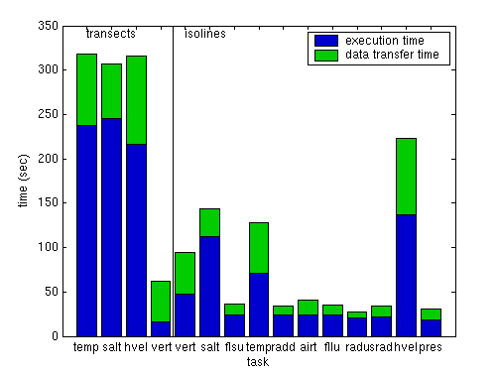
Data Transfer and Execution Times

Slide 33
Details
Split into 15 tasks, 1 per file
Compared
  random assignments
  manual data-aware and workflow-aware assignment
    Tasks that operate on same files execute at same node
    Divide long-running tasks evenly among nodes

Slide 34
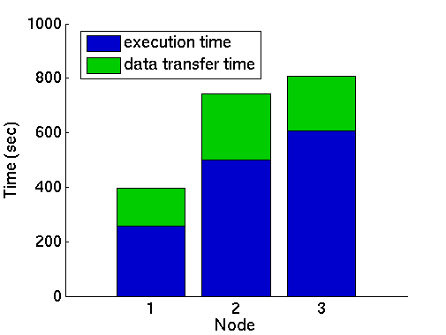
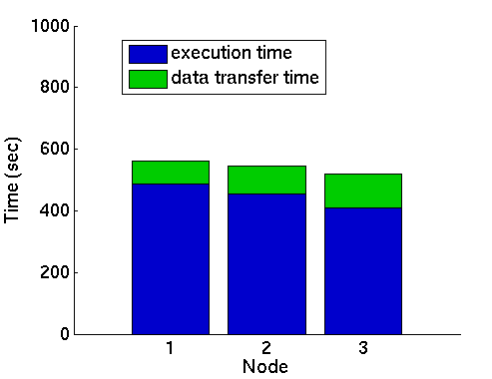
Effects of Data-Aware and Workflow-Aware Scheduling
Random assignments
Data- and workflow-aware
~800 sec > 13 min
~600 sec < 10 min

Slide 35
Outline
Introduction
CORIE Environmental Observation and Forecasting System
Implementation using Thetus
Scheduling
Related Work and Conclusions

Slide 36
Related Work
Grid Computing
  Globus, Condor, JOSH
  Job Scheduling
  Replica Management
Scientific Workflows
  Chimera, Zoo, GridDB, Kepler
Lineage Tracking
  PASOA, ESSW

Slide 37
Conclusions
Executing scientific workflows on dedicated nodes presents new challenges
Storing both data products and executables facilitates data maintenance and lineage tracking
Data-aware and workflow-aware scheduling improves task execution

Slide 38
Future work
Automatic data and workflow aware scheduling
  Use statistics from previous executions
System monitoring
Task sets
  Group related tasks into a workflow
Production planning
  Predefine workflows for future execution

Slide 39
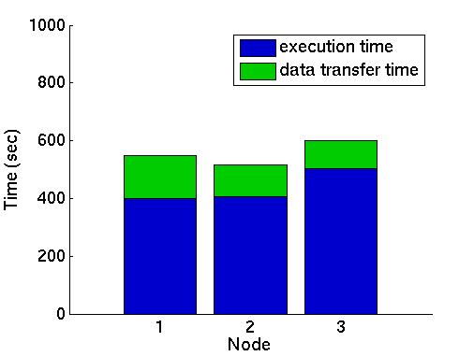
Preview of things to come…
Manual scheduling
(implementation)
Automated scheduling
(simulation)

Slide 40
Acknowledgments
Thetus Corporation
  http://www.thetuscorp.com
CORIE team
And many others…

